Slide 1
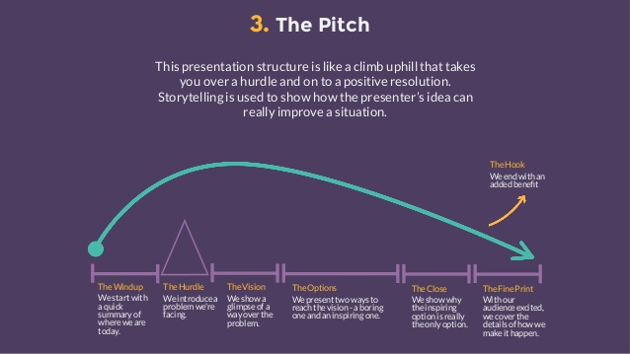
Presentation Tips And Feedback

Slide 2
Presentation Techniques
Tips for effective presenting
Show your Passion and Connect with your Audience
Be enthusiastic and honest, and the audience will respond
Focus on your Audience’s Needs
Make it easy for your audience to understand and respond
Keep it Simple: Concentrate on your Core Message
If what you are planning to say doesn’t contribute to that core message, don’t say it
Smile and Make Eye Contact
Make sure the audience sees you as well as the slides
Start Strongly
Try a story or an attention-grabbing (but useful) image on a slide.
Remember the 10-20-30 Rule for Slideshows
No more than 10 slides, no more than 10 minutes and no less that 30 point type
Tell Stories
Think about what story you are trying to tell your audience, and create your presentation to tell it.
Use your Voice and Body Effectively
Estimated that ¾ of communication is non verbal

Slide 3
Further Presentation Tips and Feedback
What are you trying to say?
Focus on your core message
Identify a goal and objective of the presentation. Be clear about what you are trying to say and what you want the audience to remember and take away
Less is more
You can not tell the audience everything. What are the most important points that you need to make? If you try to include too much your key messages with be lost in the all the other unnecessary detail
Follow a proven presentation structure
There are different presentation structures that work well to deliver different message. You can see examples of them here. https://www.youtube.com/watch?v=hMk5s1y486I&t=599s
These all take the audience through a logical journey. But two that are used often to deliver a new business idea and recommendation are The Pitch and The Explanation

Slide 4
Further Presentation Tips and Feedback
What are you trying to say?
Follow a proven presentation structure
The Windup – Set the background / current situation
The Hurdle – Explain the problem to be addressed
The Vision – How things could be better if problem solved
The Options – How the problem can be solved. Supported by facts, examples, research, data
The Close – Best recommended option and why
Fine Print – Next steps, what requirements are needed

Slide 5
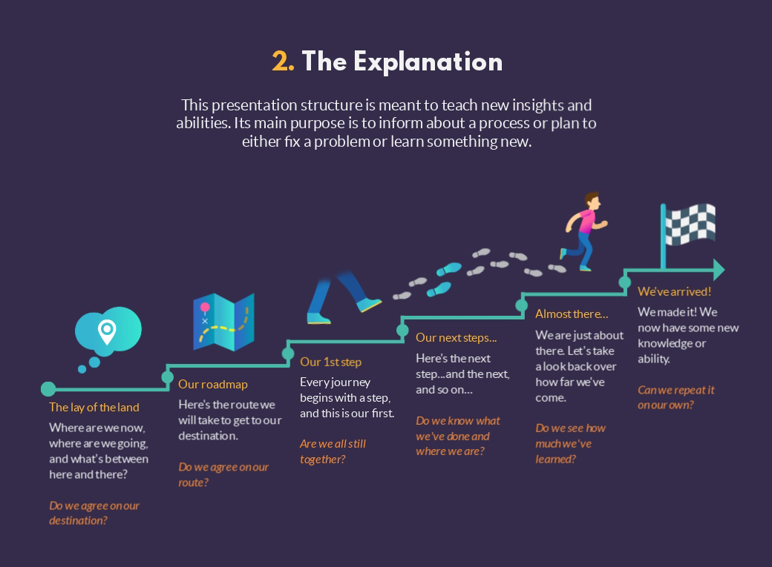
Further Presentation Tips and Feedback
What are you trying to say?
Follow a proven presentation structure

Slide 6
Further Presentation Tips and Feedback
How to deliver?
Tell a story
Humans love stories. Ideally your whole presentation should tell a story. A story can also be a good way to get peoples attention at the start of the presentation. They are also good to way of giving examples or framing a problem.
Use images and video
Too much text is hard to follow and boring. Big images, well used video (Though not too long, ideally 1-2 mins) can bring ideas and examples to life.
Read or Memorize or Bullet Points
Don’t read it. It immediately turns off the audience. This is not a speech or key-note lecture. You want to engage and connect with the audience. Can not do that when reading.
Memorizing is good, but hard. You need to practice over and over to remember a script word for word and not sound like you have just memorized it. But if you can, it makes for a fantastic delivery
Draft script and bullet points. Good middle ground is to draft a script. The process of writing out what you want to say helps to put it in your mind. Then create bullet points of the points that you want to make, or the opening sentence of the next paragraph / section on a note card or on the slides / slide notes in Powerpoint

Slide 7
Further Presentation Tips and Feedback
Stage presence
Tone & Body Language
Try to be conversation in your tone. Watch the speed of your delivery. Slower is better. Make eye contact. (Pick a couple of friendly faces in the audience, talk to them). Try not to move around too much and not make excessive hand gestures.
Preparation
Before speaking / going on stage; stride around, stand tall, visualize yourself confidently walking on stage and introducing yourself to the audience while looking them in the eye. Then breath deeply, step on the stage and do what you have just visualized.
Deliver with enthusiasm
If you believe in your content, what you are saying and the core message that you are trying to deliver, your audience will as well.
Be passionate, positive, enthusiastic. You have worked hard to prepare this content. Have confidence that you have interesting and engaging information to share that your audience wants to hear.

Slide 8

Enjoy it and look forward to the applause!

